Slide 1
Discover your
Potential

Slide 2
Agenda
All about
Welcome! We’re looking forward to getting to know you.
Here’s what you can expect from today:
Today
Meeting the team and housekeeping
A bit about us
About the job
Getting to know you:
  Group activity
  Written component
  Interviews
Notes:
Facilitator to Cover:
Welcome everyone
Introduce yourself and your role at NH
Introduce the staff supporting the assessment day
Discuss what to do in an emergency
Tell participants where they can find the bathroom
Run through agenda on slides

Slide 3
A bit about us
about
At New Horizons our promise is to put wellbeing at the heart of everything we do.
New Horizons
Established the first social enterprise in the mid 60’s
900+ team members
100+ communities
90+ government contracts
$70m annual turnover
Notes:
Facilitator to Cover:
NH is a large NFP.
We put wellbeing at the heart of what we do.
With a lot of uncertainty in the industry, New Horizons has a strong industry presence that supports our staff with a secure and stable working environment.

Slide 4
Our Vision and Purpose
It's part of our vision to see happy, inclusive communities creating opportunities.
Our Vision:
“a society in which communities work together in collaborative, inclusive ways to create opportunity and improve life”
Our Purpose:
“To provide innovative services which support individuals, strengthen communities and enhance physical social and emotional wellbeing.”
Notes:
Facilitator to Cover:
Discuss NH Vision
Discuss NH Purpose

Slide 5
Our values
Today we’re a team of more than 900 people working together to enhance wellbeing.
Notes:
Facilitator to Cover:
Explain NH values

Slide 6
Wellbeing. Done well.
We've developed the Eight Domains of Wellbeing - a best-practice model based on scientific research that helps people think constructively about their wellbeing.
Notes:
Script (if required):
At New Horizons our promise is to make a difference by putting wellbeing at the heart of everything we do. Part of that is helping people to understand how to improve their own wellbeing. That’s why we developed our unique model MyWellbeing - the 8 Domains (or MyWellbeing model for short) to help people think constructively about their wellbeing and which areas of their life they might like to focus on.
The MyWellbeing model takes some of the science and thinking behind the Canadian Index of Wellbeing, the FACS model and Maslow’s Hierarchy of Needs.
Each Domain has different principles and how you apply these principles will be very personal. It’s been designed as a tool that people can apply whatever their individual circumstances and needs. The model focusses on achieving improved wellbeing and not on detailing the specific supports or services you might receive. In this way it looks at each person in an individual, holistic way.
We hope it will empower our customers to make the right choices about their wellbeing, enable them to discover their potential and effect positive change in many areas of their lives.
Together, each of the eight domains can help you Discover, Develop, Connect and Thrive.
Coping well – Some people seem to breeze through life without a care in the world. Others may need to work at building resilience. Coping well is about developing the wherewithal and the confidence to know you can cope with whatever life brings. Try making a list of ‘triggers’ that have led to you not coping. Identifying them will help you put a plan in place to better manage them next time.
Balancing well – Managing day-to-day tasks shouldn’t detract from your overall wellbeing. Being balanced is about being able to successfully manage, plan and prioritise the various tasks on your ‘to do’ list. Try breaking down your ‘to do’ list into a priority list. This will help you feel organised and less overwhelmed.
Living well – When we talk about living well, we don’t mean living lavishly. It’s about feeling safe and secure in your everyday environment, having a place to call home, and living without fear. If you don’t feel safe, talk to someone you trust about why.
Integrating well – Having meaningful, supportive relationships helps us to feel a part of something and connected to the wider community. As a social enterprise this is something New Horizons lives every day. While you’re in charge of your own wellbeing, feeling you belong and have the support of others can help you achieve great things. Why not call a friend you haven’t spoken for a while and re-connect?
Physically well – Simply put, this is about looking after ourselves. We all have days when we don’t feel our best. Being physically well is about being as well and healthy as you can be on any given day – whatever that means for you. For some that might be running a half marathon, for others it might be as simple as being more active or making healthy lifestyle choices. Set yourself goals, think about what motivates you and what makes you feel good, then do it.
Feeling well – There have been moments in my life where I’ve felt immense pride in my achievements, and not just the ‘big things’. Feeling well is not just about accomplishing things and celebrating our achievements, but also celebrating our progress along the way, whether that’s trying a new hobby or getting a better grip on your finances.
Independently well – Everyone has the right to make their own decisions. For some this comes naturally while for others it requires learning new life skills to help them be confident enough. That’s why New Horizons empowers our customers to be in control of their own journey. Independence is really important for wellbeing and helps people feel self-assured and determined. Take some time to think about what you really want and what decisions must be made to achieve it.
Growing well – When you feel confident about your future you’re able to actively pursue personal development. That’s what growing is all about. But personal growth isn’t just about looking inward. When you’re growing well, you are able to help other people to achieve their goals and aspirations. You’re able to explore the possibilities and discover your potential. What could you do today to challenge yourself or reach a goal? Or if you know someone with a specific goal they’re aiming for – how could you help them?
We promise to put wellbeing at the heart of everything we do and the MyWellbeing model will help us do that. We’ve already started using it with our customers to improve their wellbeing through identifying areas for improvement and goal setting.

Slide 7
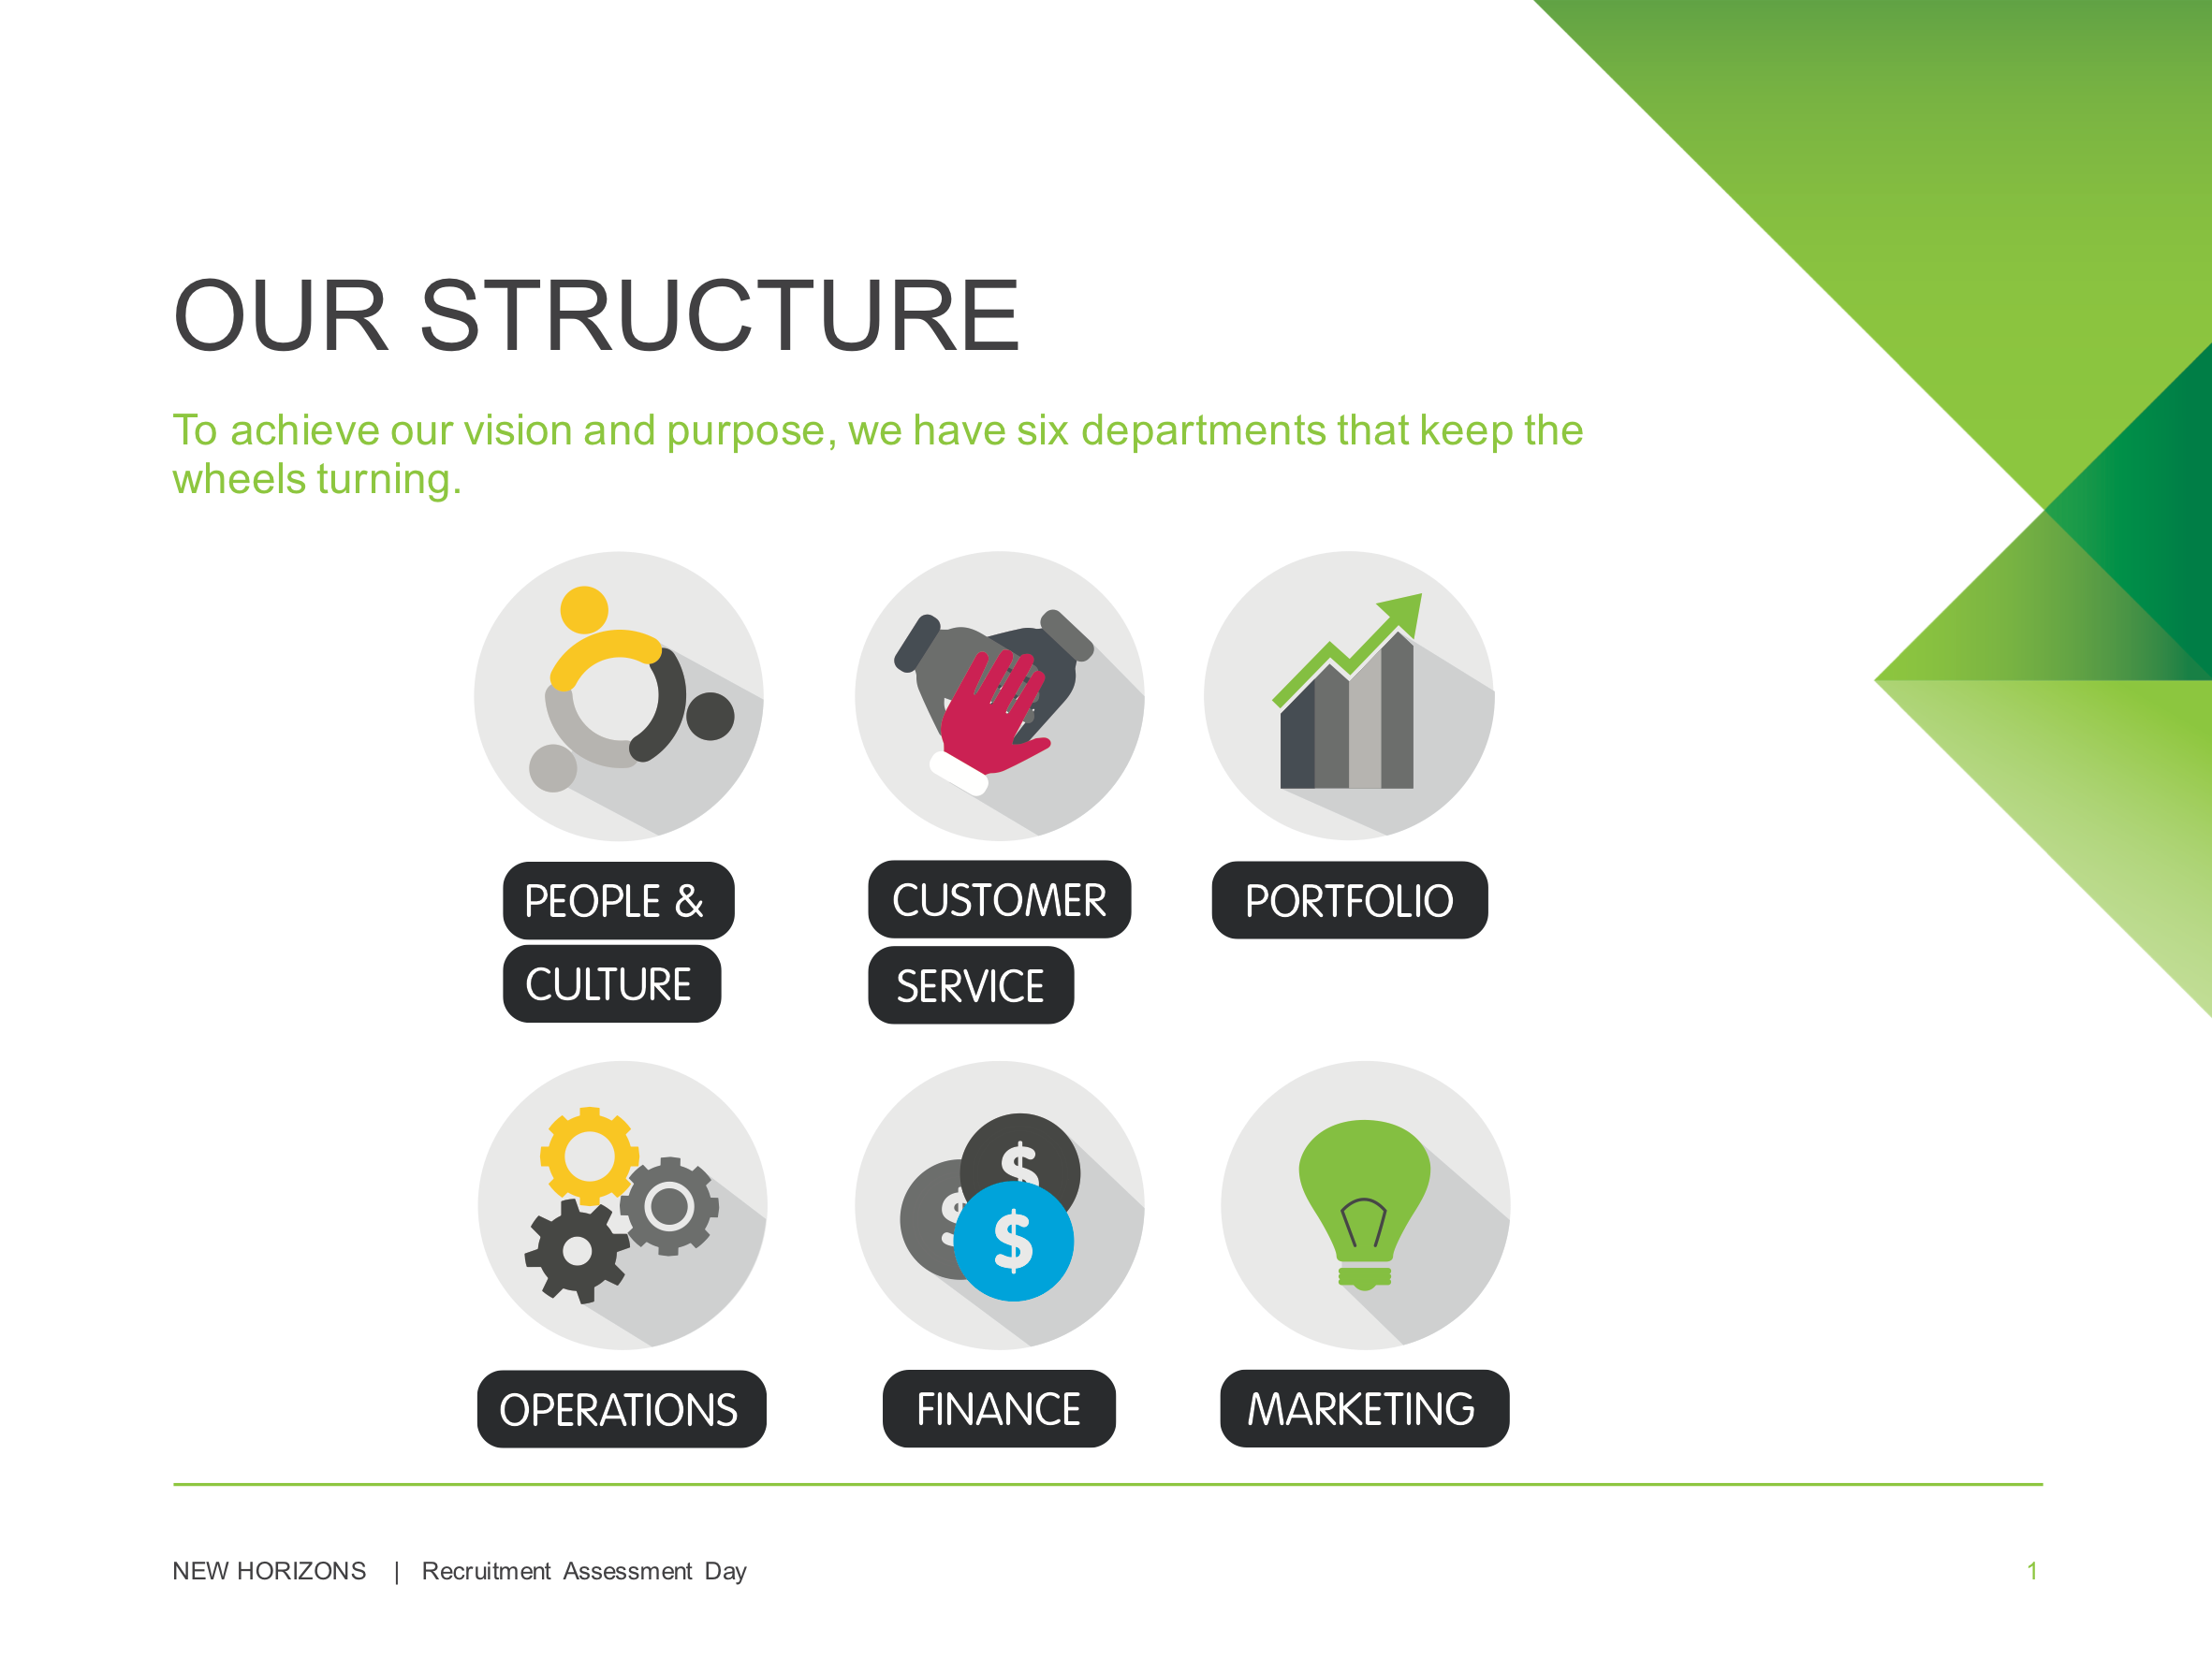
Notes:
Script (if required):
The role you’re applying for sits in the Customer Service Department. We’ll look at the structure of Customer Services in a moment.
Its also helpful to know that we have five other departments that support NH operations. These departments are based in North Ryde.

Slide 8
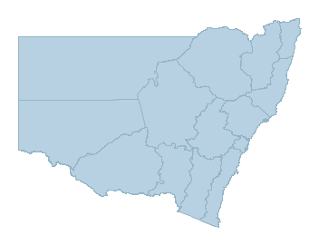
Our Regions
Customer
We provide specialist aged care, disability, homeless, humanitarian, Indigenous, justice, mental health and youth support services across 6 Regions
service
Far North Coast
Mid North Coast
Hunter
Central Coast
Greater Sydney
Sydney
Notes:
Script (if required):
Customer Service Department is separated into Six Regions. We provide a wide range of services throughout NSW.
Lets take a closer look at the Region you’ll be working in.

Slide 9
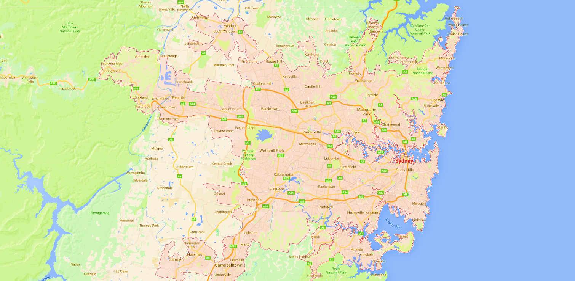
Sydney & Greater Sydney
We focus on a person centred approach. Our staff support customers across the traditional funding programs. Each Region is split into ‘Hubs’.
This means our support workers get variety in their job and break away from silos in service!
Greater Sydney Region
North Shore and Northern Beaches
Liverpool, Cambelltown, Bankstown
Ryde and Hornsby
Sydney Region
Holroyd & Hills
Inner West
Notes:
Script (if required):
Two Regions exist in Sydney. We have the Sydney and Greater Sydney Regions.
This slide shows the Regional Hubs for each Region.
Within each hub we have a number of different services and programs, but each staff member works across the Customers in the hub. A good example is one support worker could support a customer from a HASI program one day, and an Individual Support Package at their next appointment.
This means when you work for New Horizons your work has a good variety, you wont be pigeon holed into a specific type of work. It’s a way of supporting our customers based on their needs, not their funding body.

Slide 10
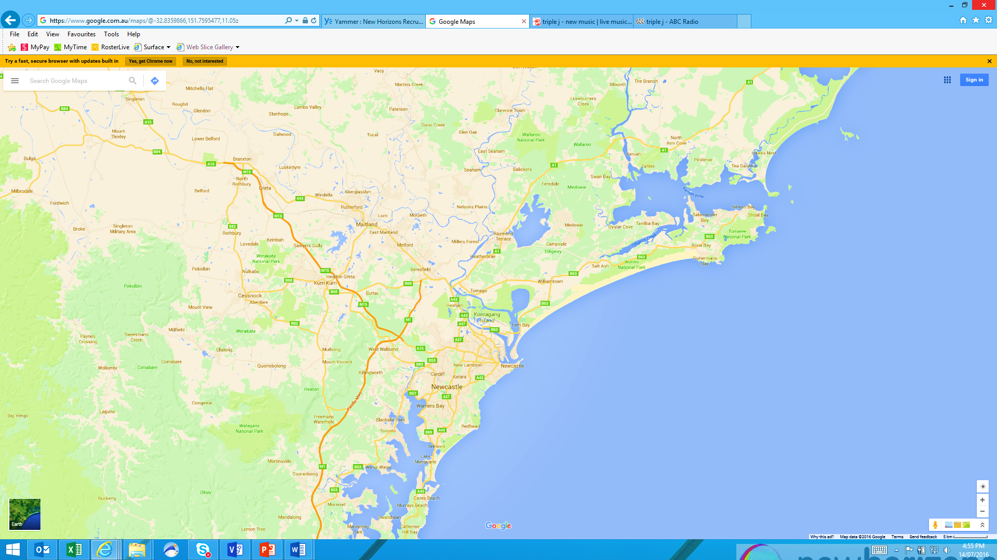
hunter
We focus on a person centred approach. Our staff support customers across the traditional funding programs. Each Region is split into ‘Hubs’.
This means our support workers get variety in their job and break away from silos in service!
Greater Newcastle
Newcastle
Notes:
Script (if required):
Within the Hunter Region, we have two Hubs.
Each hub has a number of different services and programs, and our staff members works across the Customers in the hub. A good example is one support worker could support a customer from a HASI program one day, and an Individual Support Package at their next appointment.
This means when you work for New Horizons your work has a good variety, you wont be pigeon holed into a specific type of work. It’s a way of supporting our customers based on their needs, not their funding body.

Slide 11
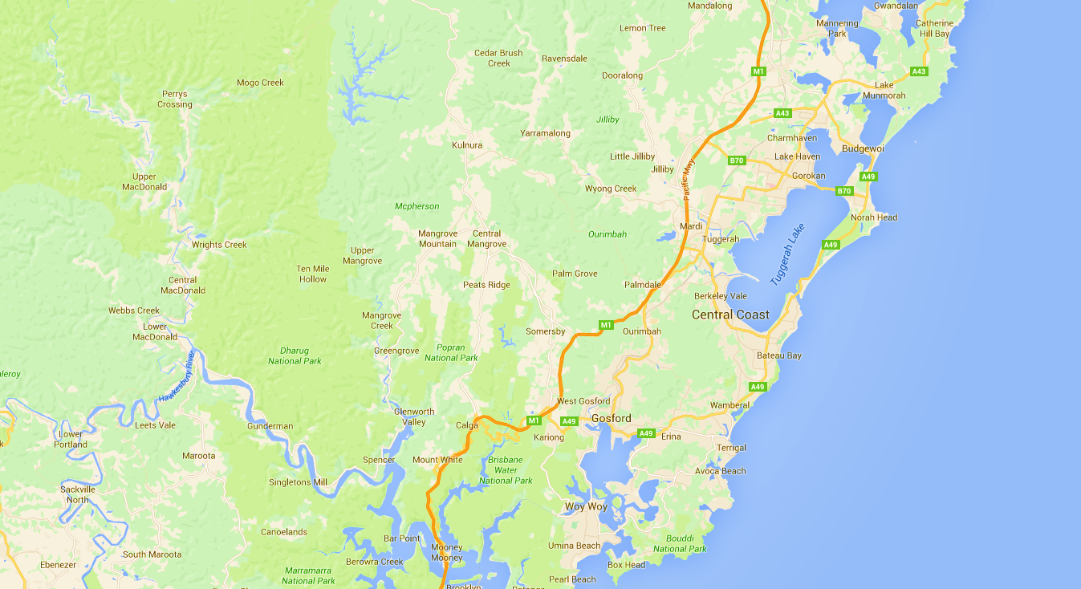
Central coast
We focus on a person centred approach. Our staff support customers across the traditional funding programs. Each Region is split into ‘Hubs’.
This means our support workers get variety in their job and break away from silos in service!
Central Coast North
Central Coast South
Notes:
Script (if required):
Within the Central Coast Region, we have two Hubs.
Each hub has a number of different services and programs, and our staff members works across the Customers in the hub. A good example is one support worker could support a customer from a HASI program one day, and an Individual Support Package at their next appointment.
This means when you work for New Horizons your work has a good variety, you wont be pigeon holed into a specific type of work. It’s a way of supporting our customers based on their needs, not their funding body.

Slide 12
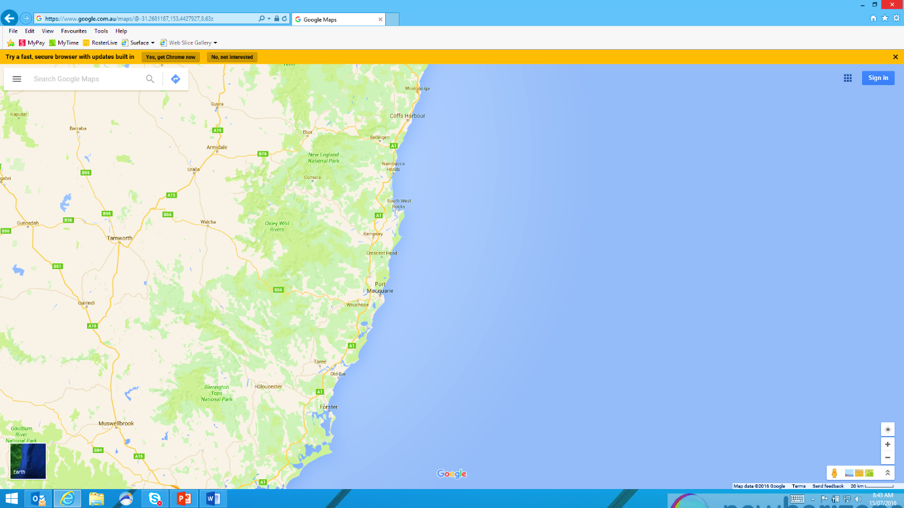
Mid north coast
We focus on a person centred approach. Our staff support customers across the traditional funding programs. Each Region is split into ‘Hubs’.
This means our support workers get variety in their job and break away from silos in service!
Coffs Harbour & Grafton
Kempsey
Port Macquarie
Taree
Notes:
Script (if required):
Within the Mid North Coast Region, we have Four Hubs.
Each hub has a number of different services and programs, and our staff members works across the Customers in the hub. A good example is one support worker could support a customer from a HASI program one day, and an Individual Support Package at their next appointment.
This means when you work for New Horizons your work has a good variety, you wont be pigeon holed into a specific type of work. It’s a way of supporting our customers based on their needs, not their funding body.

Slide 13
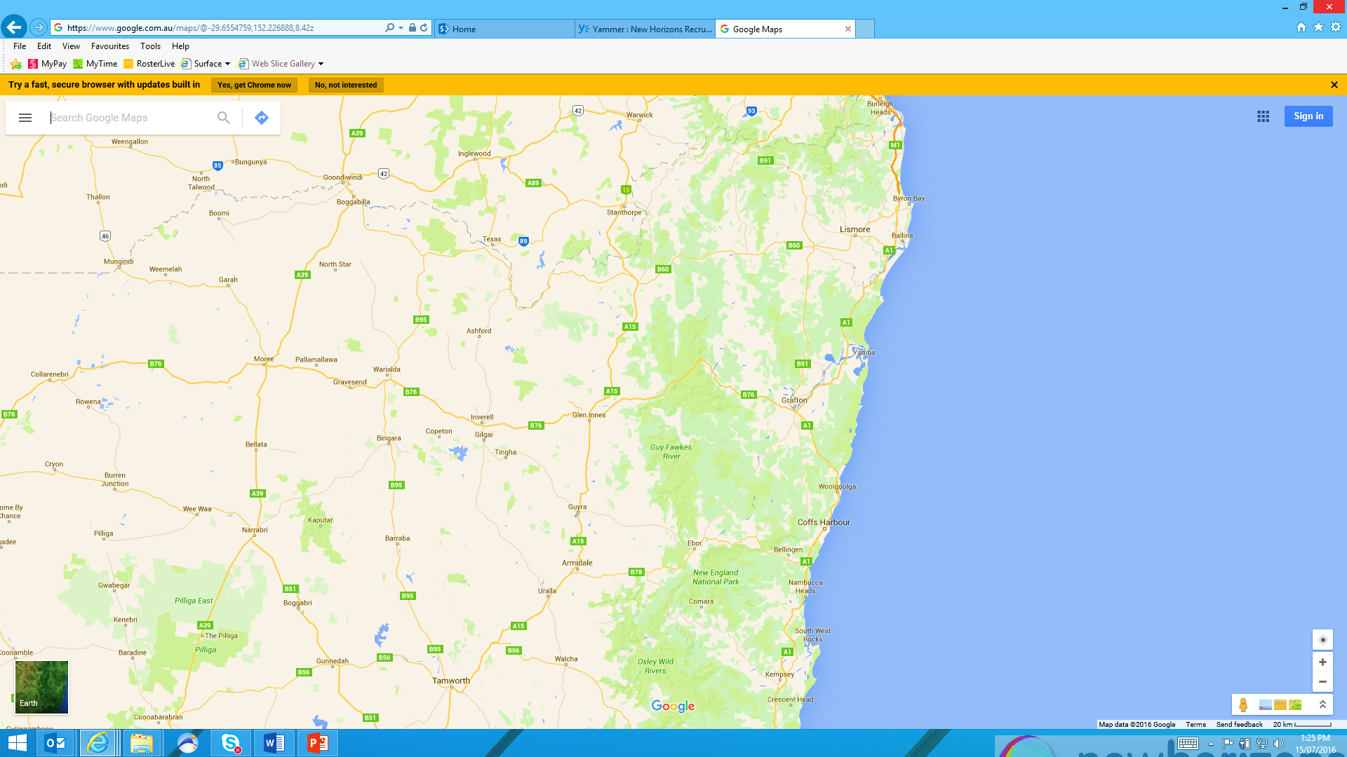
Far north coast
We focus on a person centred approach. Our staff support customers across the traditional funding programs. Each Region is split into ‘Hubs’.
This means our support workers get variety in their job and break away from silos in service!
Tweed Heads
Lismore
New England
Notes:
Script (if required):
Within the Far North Coast Region, we have three Hubs.
Each hub has a number of different services and programs, and our staff members works across the Customers in the hub. A good example is one support worker could support a customer from a HASI program one day, and an Individual Support Package at their next appointment.
This means when you work for New Horizons your work has a good variety, you wont be pigeon holed into a specific type of work. It’s a way of supporting our customers based on their needs, not their funding body.

Slide 14
Support Worker
About the
We’re driven by our desire to help people uncover their possibilities and improve their quality of life.
job
https://youtu.be/zfNZNDsWMvU
Notes:
Script (if required):
We know the people who work with us are our biggest asset. Let’s take a look at how much it means to our customers.

Slide 15
The day to day
You’ll work across our Regional Hubs to provide services to our customers.
Caring & Supportive
Advocacy & Liaison
Support for Daily Living
Personal & Domestic Care
Accommodation & Tenancy Support
Meals, Medication & Hygiene
Family & Carer Support
Budgeting Assistance
Enabling & Life Building
Leisure & Recreational
Community Participation
Healthy Lifestyle Planning
Individual or group-based activities
Employment, Training & Education
Social skills development
Coaching & Mentoring
Peer Support
Notes:
Script (if required):
“When you work within a Hub, you could provide support in one of 2 different types of teams. Each hub as a C&S team and an ELB team.”
Facilitator to Cover:
Explain the type of work that the Caring and Supportive team does specific to Region.
Explain the type of work that the ELB team does specific to Region.
Give a realistic preview. Make sure candidates understand the opportunities AND the challenges they can expect in each team

Slide 16
Why work with us?
We look for highly motivated, skilled talent who share our values of passion, integrity and respect.
If you’re looking for somewhere to pursue your passion, demonstrate your initiative and make a difference you could benefit from:
Competitive remuneration package and hourly rates
$15900+ in tax free salary packaging for permanent staff
Professional development, learning opportunities and secondments
Flexible work arrangements where appropriate
Employee Wellness program
A supportive team culture and work environment
Notes:
Facilitator to Cover:
Cover details on slide

Slide 17
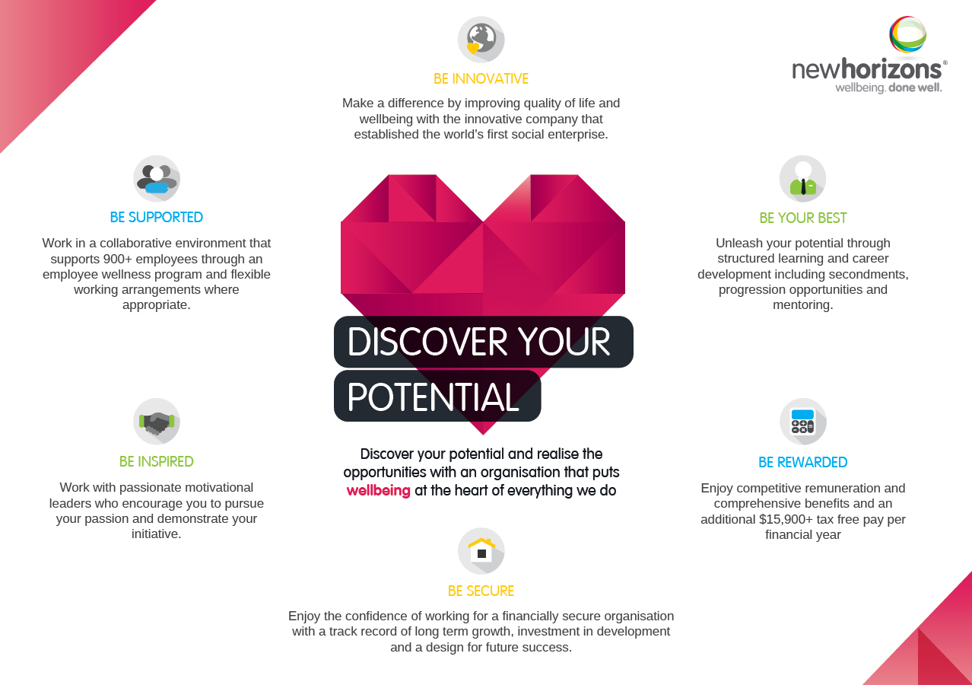
Notes:
Facilitator Script (if required):
This is the NH Employer Value Proposition. Take some time to read each of the six points, this is what we as a company takes pride in offering the people who work with us.

Slide 18
Where to from here?
What to
After today, you’ll hear back from our Recruitment Team about whether your application is progressed
expect
Written exercise
Group activity
Interviews
Notes:
Facilitator Script (if required):
In a moment, We’ll get started with getting to know each of you.
At the end of the activities, you’ll meet with our facilitators for an interview; and you’ll be able to head off and enjoy the rest of your day after that’s complete.
You can expect to hear back from the Recruitment Team about your application within 5 days, and your welcome to contact them if you have any questions or concerns after today. If your application is progressed they will work with you to collect the background check and police checks needed to start in the job.
If your application is progressed, its really important to apply for the Working with Children Check and Police Check as soon as they let you know. This is normally the biggest hold up as the checks take a few weeks to complete if you haven’t got them already, and you wont be able to start with us until we receive them.

Slide 19
Questions?
Notes:
Facilitator Script (if required)
Does anyone have any questions before we get started?

Slide 20
Lets get started!

