Slide 1
Manager Workplace Health and Safety
Woorabinda Aboriginal Shire Council

Slide 2

About the Role
Position Purpose
To assist in the development, implantation and co-ordination of Council's safety Management system in aaccrodance with legislative requirements .

Slide 3
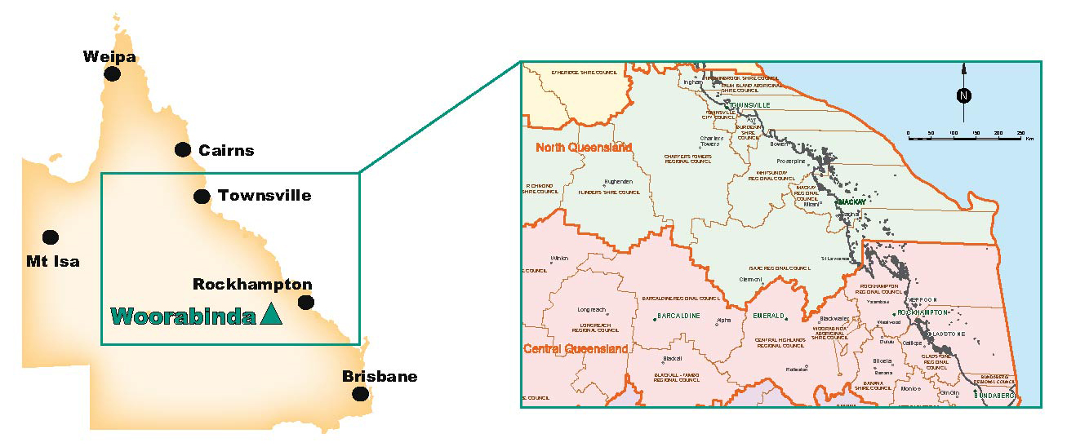
Woorabinda is located 170km south-west of Rockhampton and covers an area of 391.2 square km. The Shire has a population of 928. Woorabinda means "kangaroo - sit down". Woorabinda was established in 1927, and the community was practically maintained and sustained through 'stockwork', that led to the formation of the Woorabinda Pastoral Company. The Woorabinda Local Government Shire consists of 5 parcels of land with a total area of approx. 39,000 hectares which are held by Council under a Deed of Grant in Trust (DOGIT).
Woorabinda has a pastoral company, a hospital, a community hall, a sports complex, a swimming pool, a general store and a primary school (1928). There are two churches and the Aboriginal Inland Mission has resident lay pastors. Police are stationed within the community and a emergency services base is located next door. An airstrip is located near the town.
A full settlement history is captured on the website www.woorabinda.qld.gov.au/visageimages/History.pdf

Slide 4
The Position
Key Responsibilities
Provide strategic advice, analysis, interpretation, and recommendations on business risks, safety management and legislative compliance.
Identify and manage business compliance, safety and operational risk frameworks and registers.
Develop and review business documentation and risk management controls to align with business objectives and to achieve safety and compliance obligations.
Manage safety, incident and compliance performance
ce data and communicate business performance to assist decision making and continuous
Coordinate work-related investigations, audits and inspections and provide advice on appropriate corrective action, control measures and early intervention services.
Review training and professional development opportunities including mandatory training for council staff.
Maintain training programs, resources and records; and coordinate and/or implement training activities.
Undertake projects and activities as required by the CEO
Ensure compliance with relevant legislation and University policies and procedures, including equity and health & safety and exhibit good practice in relation to same.
Position Requirements
Completion of relevant tertiary qualifications in safety, risk and compliance or an equivalent combination of business knowledge, training and experience is highly desirable
Cert IV in Training and Assessment and/or the ability to establish and implement training plans incorporating appropriate training methodology to meet legislative standards.
Proven extensive knowledge of related legislation and risk management principles and demonstrated ability to apply appropriate operational control measures.
Demonstrated ability to interpret, apply and advise on safety and compliance policies, procedures and legislation.
Demonstrated investigation, research, analytical and creative problem solving skills in the provision of solution based strategic and operational business content.
Demonstrated ability to work harmoniously as part of a team with strong interpersonal skills to actively engage with diverse client groups including staff and representatives of external organisations.
Demonstrated high level computer literacy

Slide 5
Conditions
Base Salary of up to $92,000
Superannuation and salary sacrifice options
Accommodation 2/3 Bedroom Council house dependent on need with a rental value of $55/$95 per week deducted from fortnightly salary.

